Slide 1
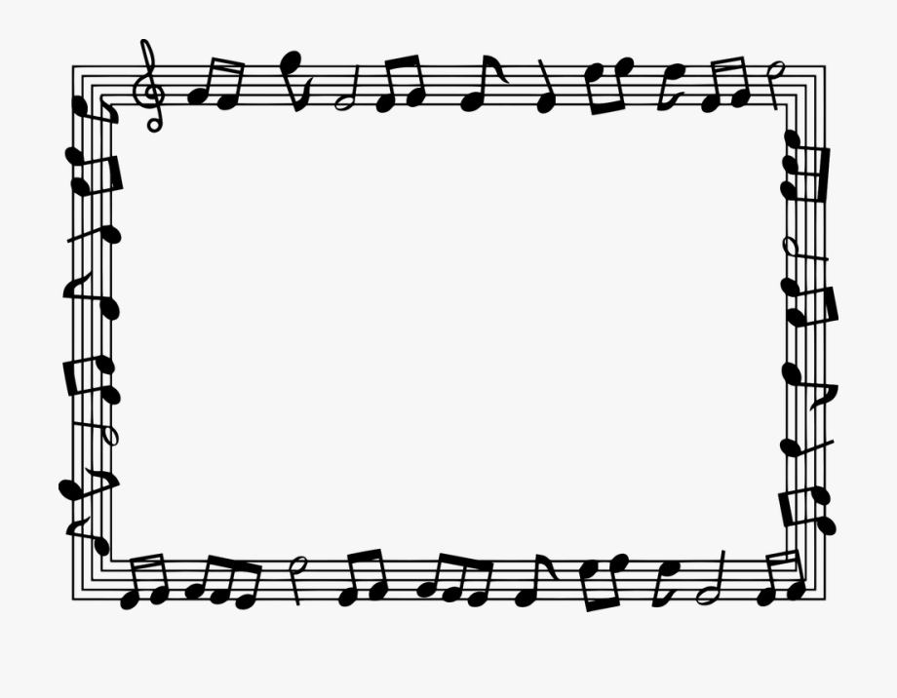
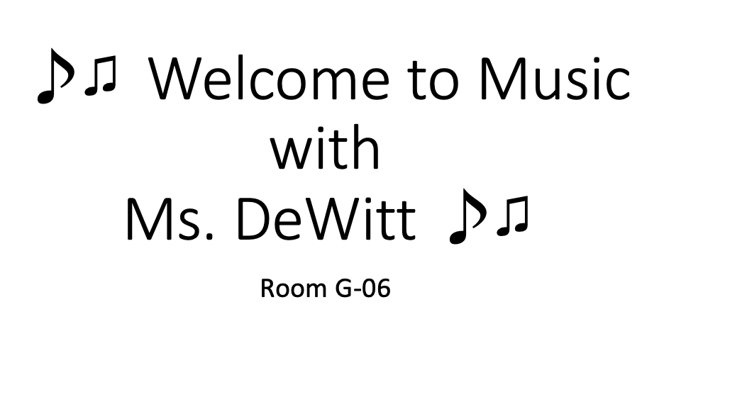
♪♫ Welcome to Music with
Ms. DeWitt ♪♫
Room G-06

Slide 2
Questions?
If you have any questions at any point during this presentation or throughout the school year, please contact me via email at ashldewitt@paps.net

Slide 3
What do I teach?
Piano
Chorus
General music
For grades 6-8

Slide 4
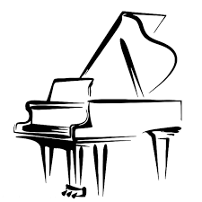
Make good choices: students should be on time and prepared to participate in class on their laptops. Cell phones are not permitted during class time. Students are to try to work in a quiet space with minimal distractions to ensure that the learning time is efficient.
Use equipment properly: students must remain visible with cameras on throughout the entirety of each class period.
Speak and play when the time is right: student microphones must be on mute unless he/she has permission. We are patient and respectful while other students and teachers are speaking.
Involve yourself: all students will try their personal best in music class.
Cooperate with others: students are to be respectful to all of their classmates and teachers.

Slide 5

Things You Should Know
The teacher takes attendance during the first five minutes of class. If students enter the classroom after attendance is done, then they are marked tardy.
Google Classroom Assignments and Homework: The teacher will always give advanced notification of any upcoming assignments and homework. The students can speak to the teacher regarding completion of any late assignments, as long as it is within the marking period. As a way to supplement our daily instruction, all students should join our Google Classroom for assignments, sheet music, and rubrics.
It is my expectation that all students will try their personal best in class.

Slide 6
District Grading Policy
60% Assessments: tests, quizzes, performances, etc.
35% Classwork: participation, daily music listening activities and discussions, projects, exit tickets, etc.
5% Homework: piano practice, etc.

Slide 7
What the students will accomplish this year:
Identification of the notes on the Treble and Bass Clef staff, key signatures, chords, articulation, tempo and dynamic markings, etc.
Exploration of the solfège system
Identification of letters on the piano and corresponding pitch location on the staff
Ownership of their own musicianship skills
And more!

Slide 8
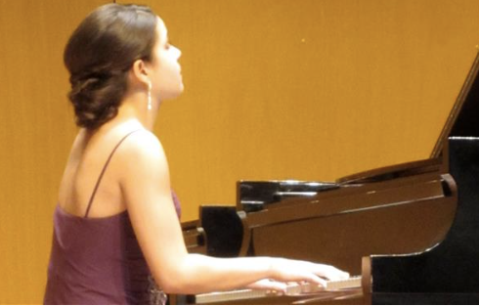
Contact Ms. DeWitt ♪♫
If you have any questions now or throughout the school year please contact me by e-mail at ashldewitt@paps.net
Take a look at my teacher website: https://www.paps.net/Domain/3922

Slide 9
Thank You!
I look forward to making music with your child

